Slide 1
MSiA 490_SEC20 Special Topics: Text Analytics
Wang, Timo

Slide 2
Word2Vec
2. Lab

Slide 3
What

Slide 4
Why

Slide 5
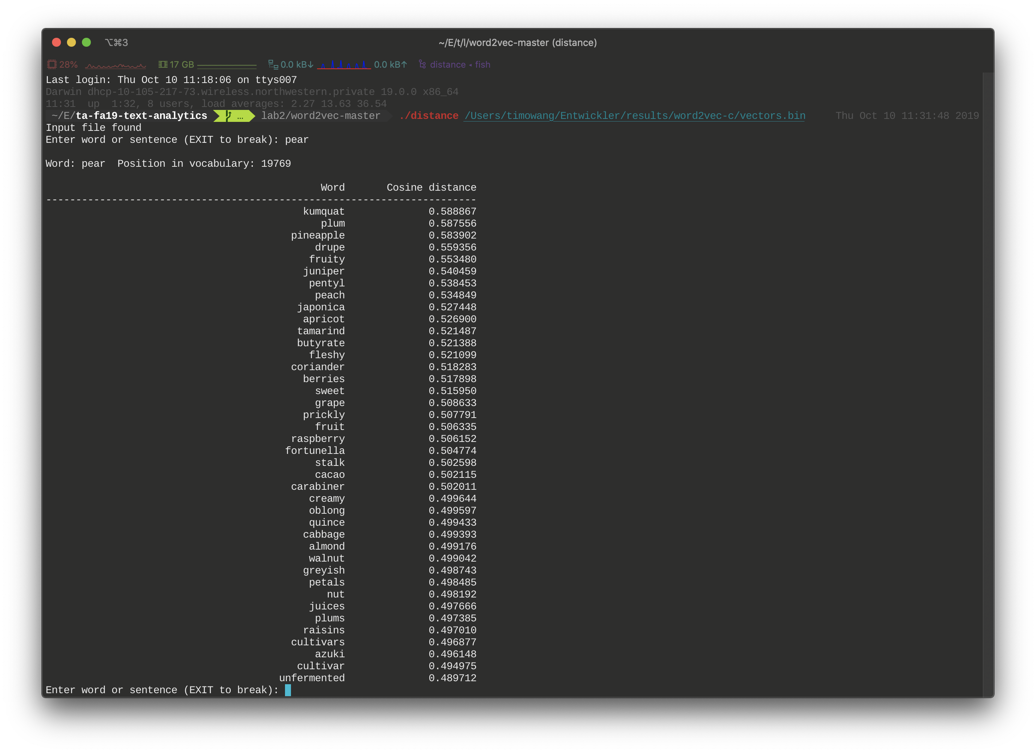
Why

Slide 6
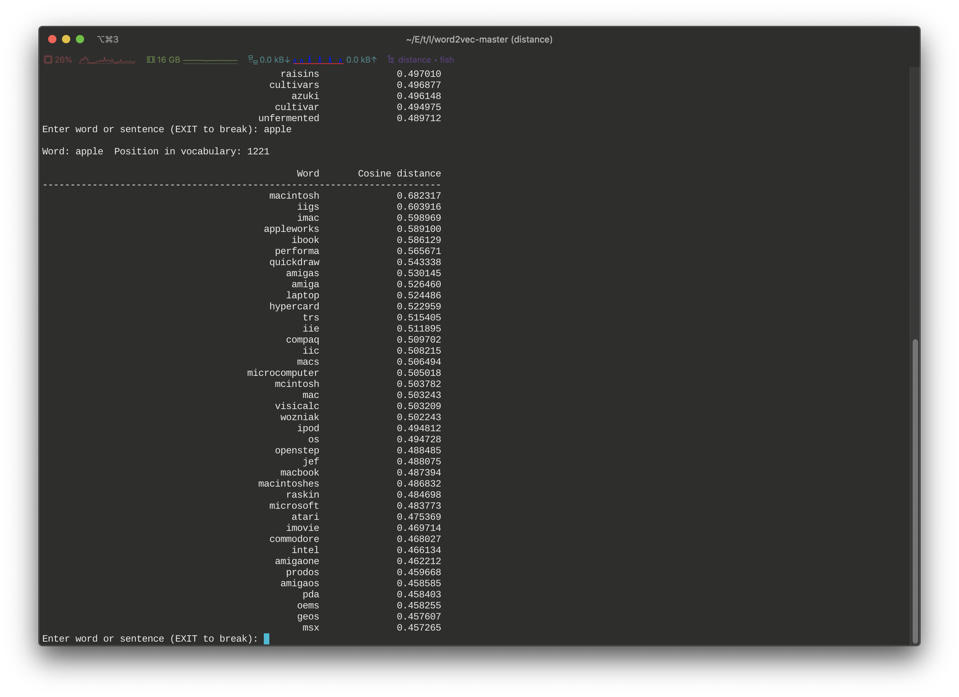
Why

Slide 7
How

Slide 8
Option 1 – The Original C Library
Step1 – Download the project from https://github.com/tmikolov/word2vec
Step 2 – Read demo-word.sh
Step 3 – Follow the script as a guideline and train on your own corpus

Slide 9
Option 1 – The Original C Library
Tips for troubleshooting (macOS Catalina)
./distance results in a segmentation fault
=> remove -march=native from makefile
Undefined symbols for architecture x86_64: "_fgetc_unlocked", referenced from:
=> replace fgetc_unlocked with getc_unlocked , fputc_unlocked with putc_unlocked.

Slide 10
Option 2 – Gensim Library
Step 1 – Download Gensim library through pip
Step 2 – Load and format the corpus as required: List[List[str]]
Step 3 – Train and save the Word2Vec model
Step 4 – Play with the word embeddings

Slide 11
Option 2 – Gensim Library
More details and tutorials
https://towardsdatascience.com/a-beginners-guide-to-word-embedding-with-gensim-word2vec-model-5970fa56cc92
https://radimrehurek.com/gensim/models/word2vec.html

Slide 12
One More Thing
Geoffrey Hinton and Yann LeCun, 2018 ACM Turing Award Lecture "The Deep Learning Revolution"

